Slide 1
Advanced Modeling for Distribution Planning with OpenDSS
Instructor
Roger C. Dugan Sr. Technical Executive Sacramento, California June 22-23, 2017

Slide 2

Instructor
Roger C. Dugan, Life Fellow, IEEE
Roger is a Sr. Technical Executive with EPRI in Knoxville, Tennessee USA. He has over 45 years of combined experience in distribution engineering with EPRI, Electrotek Concepts, and Cooper Power Systems. He holds the BSEE degree from Ohio University and the Master of Engineering in Electric Power Engineering degree from Rensselaer Polytechnic Institute, Troy, NY. Roger has worked on many diverse aspects of power engineering over his career because of his interests in applying computer methods to power system simulation. Beginning with a student internship with Columbus and Southern Ohio Electric Co, his work has been focused on Distribution Engineering. He was elected a Fellow of the IEEE for his contributions in harmonics and transients analysis. Recently, he has been very active in distributed generation, particularly as it applies to utility distribution systems and distribution system analysis. He was the 2005 recipient of the IEEE Excellence in Distribution Engineering Award. He is coauthor of Electrical Power Systems Quality published by McGraw-Hill, now in its 3rd edition. He serves on the IEEE PES Distribution System Analysis Subcommittee and is active in the Distribution Test Feeders WG.

Slide 3
COM Interface Example
In Excel VBA

Slide 4
Three Implementations of OpenDSS
Stand-alone EXE
32-bit
64-bit
Use this to develop text scripts to study problems
In-Process COM Server
32-bit
64-bit
Use this to link OpenDSS to other programs
Automate the program
Execute complex algorithms
DirectDLL API
Use this to link OpenDSS to other programs on platforms/languages that do not support COM

Slide 5
DSS Structure
Text
Scripts
Main Simulation Engine
COM Interface
User-Written DLLs
Scripts, Results

Slide 6
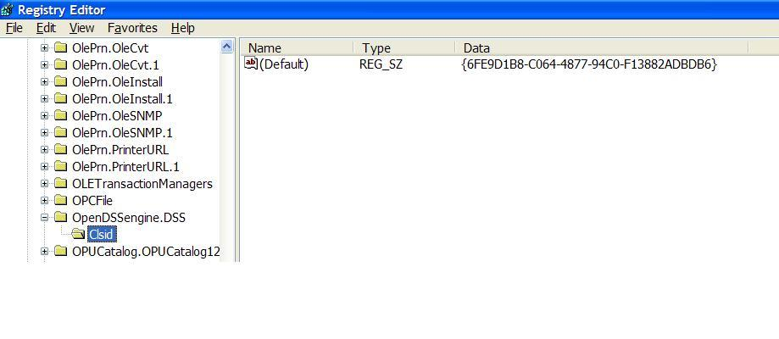
OpenDSSEngine.DSS is Registered
Windows Registry Entry
GUID
The Server shows up as “OpenDSSEngine.DSS” in the Windows Registry
The OpenDSS is now available to any program on the computer

Slide 7
Linking Your Program to the COM Server
Examples of accessing the COM server in various languages
In MATLAB:
DSSobj = actxserver(‘OpenDSSEngine.DSS’);
In VBA: (Early binding)
Public DSSobj As OpenDSSEngine.DSS Set DSSobj = New OpenDSSEngine.DSS
In Dephi
{Import Type Library}
DSSObj := coDSS.Create;
In PYTHON:
self.engine = win32com.client.Dispatch("OpenDSSEngine.DSS")

Slide 8
OpenDSS COM Interfaces
There are many interfaces supplied by the OpenDSSEngine In-Process COM server
There is one registered In-Process COM interface:
OpenDSSEngine.DSS
The DSS interface is the one your program instantiates
The DSS interface then creates all the others.
This is for simplicity for users who are not necessarily familiar with COM programming

Slide 9
“Active objects” concept
.The interfaces generally act on the ACTIVE object
Active circuit,
Active circuit element,
Active bus, etc.
The interfaces generally point to the active object
To work with another object, change the active object
There are methods for selecting objects
You may also use script commands

Slide 10
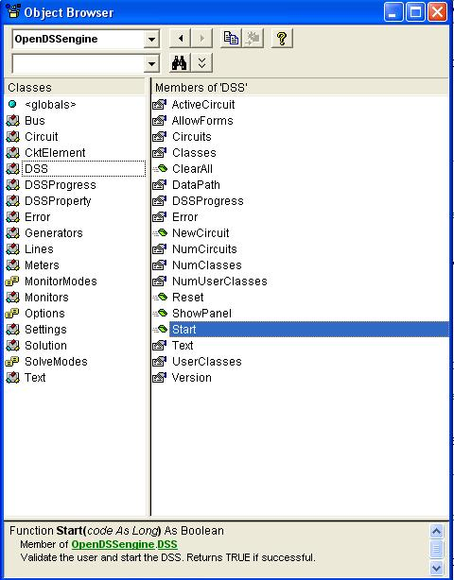
The DSS Interface
This is the main interface. It is instantiated upon loading OpenDSSEngine.DSS and then instantiates all other interfaces internally
Call the Start(0) method to initialize the DSS
DSS Class Functions (methods) and Properties

Slide 11
COM with a Simple VBA Macro (Class Exercise)
Run the IEEE 123-bus Test Feeder and plot the voltage profile

Slide 12
The VBA Code
Option Explicit
Public MyOpenDSS As OpenDSSengine.DSS
Public MyText As OpenDSSengine.Text
Public MyCircuit As OpenDSSengine.Circuit
Public Sub MyMacro()
Set MyOpenDSS = New OpenDSSengine.DSS
MyOpenDSS.Start (0)
Set MyText = MyOpenDSS.Text
Set MyCircuit = MyOpenDSS.ActiveCircuit
MyText.Command = "Compile (C:\OpenDSS\IEEETestCases\123Bus\IEEE123Master.dss)"
MyText.Command = "New Energymeter.M1 element=Line.L115 terminal=1"
MyText.Command = "Solve"
Dim MyVoltages As Variant
Dim MyNames As Variant
Dim Mydistances As Variant
MyVoltages = MyCircuit.AllBusVmagPu
MyNames = MyCircuit.AllNodeNames
Mydistances = MyCircuit.AllNodeDistances
Dim i As Integer, irow As Integer
irow = 1
For i = LBound(MyVoltages) To UBound(MyVoltages)
ActiveSheet.Cells(irow, 1).Value = MyNames(i)
ActiveSheet.Cells(irow, 2).Value = Mydistances(i)
ActiveSheet.Cells(irow, 3).Value = MyVoltages(i)
irow = irow + 1
Next I
Set MyOpenDSS = Nothing
End Sub

Slide 13
Steps Require to Do This
Register OpenDSSEngine.DLL
(32-bit if your Excel is 32-bit)
Done automatically if you use the OpenDSS Installer
Start Microsoft Excel
Type alt-F11 to open VBA editor
Or Tools>Macro …
Select OpenDSS Engine under Tools>References
Insert>Module
Enter the VBA code into blank module
Use correct path name for your computer
Execute the macro “MyMacro”

Slide 14
Resulting Chart in Excel

Slide 15
Now change the load multiplier to 0.40 (40% of peak) and repeat …

Slide 16
Option Explicit
Public MyOpenDSS As OpenDSSengine.DSS
Public MyText As OpenDSSengine.Text
Public MyCircuit As OpenDSSengine.Circuit
Public Sub MyMacro()
Set MyOpenDSS = New OpenDSSengine.DSS
MyOpenDSS.Start (0)
Set MyText = MyOpenDSS.Text
Set MyCircuit = MyOpenDSS.ActiveCircuit
MyText.Command = "Compile (C:\OpenDSS\IEEETestCases\123Bus\IEEE123Master.dss)"
MyText.Command = "New Energymeter.M1 element=Line.L115 terminal=1"
MyText.Command = "Solve“
MyText.Command = “Set Loadmult=0.40"
MyCircuit.Solution.Solve ‘ Solve by call to interface rather than using Text
Dim MyVoltages As Variant
Dim MyNames As Variant
Dim Mydistances As Variant
MyVoltages = MyCircuit.AllBusVmagPu
MyNames = MyCircuit.AllNodeNames
Mydistances = MyCircuit.AllNodeDistances
Dim i As Integer, irow As Integer
irow = 1
For i = LBound(MyVoltages) To UBound(MyVoltages)
ActiveSheet.Cells(irow, 1).Value = MyNames(i)
ActiveSheet.Cells(irow, 2).Value = Mydistances(i)
ActiveSheet.Cells(irow, 3).Value = MyVoltages(i)
irow = irow + 1
Next I
Set MyOpenDSS = Nothing
End Sub

Slide 17
Resulting Chart in Excel at 40% Load

Slide 18
COM Server and Matlab Examples

Slide 19
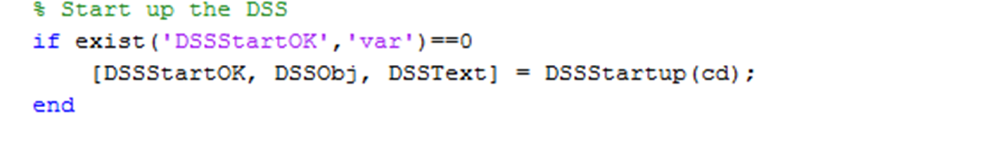
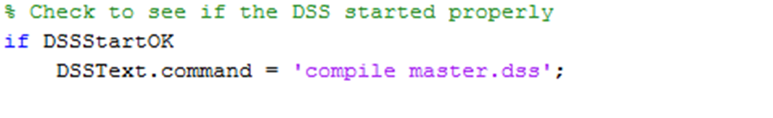
Create a New Matlab .m file
DSSStartup.m must be in the same directory
First statement in the new file must activate OpenDSS COM object
The next statement checks if DSS loaded correctly and then compiles the simple feeder

Slide 20
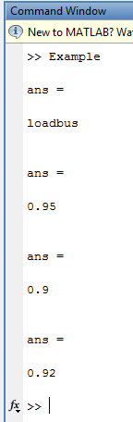
Communicate with the DSS Model
Select and examine an elements properties
Modify the load power factor explicitly
Modify the load power factor generically

Slide 21
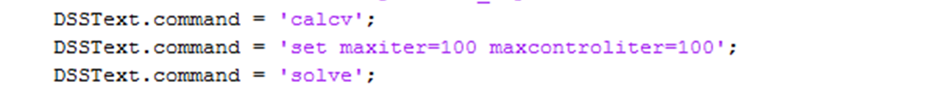
Add an Element to the Model
Text based command
Add PV system
Calc V to refresh voltage bases
Modify settings
Solve

Slide 22
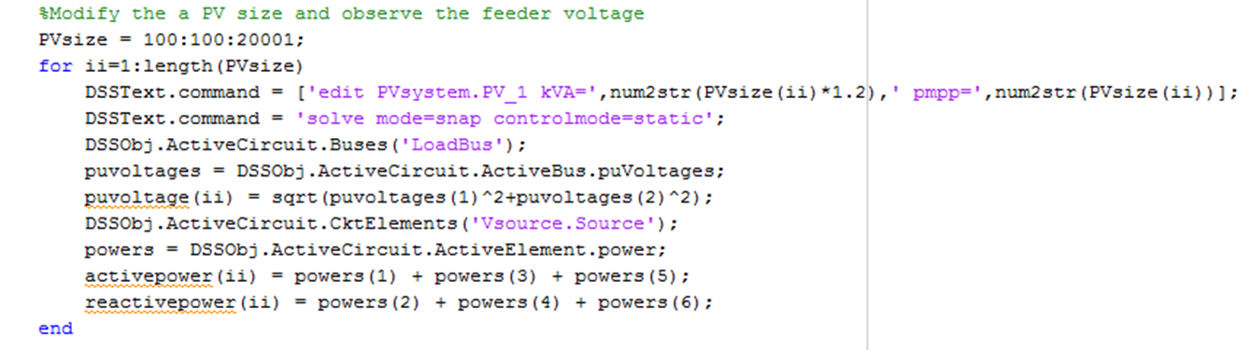
Scripting for Automated Analysis
Analyze different size PV systems to determine when ANSI voltage limits are violated
Record voltages
Record power flow

